Slide 1
Multimedia, Colors & The World Wide Web

Slide 2
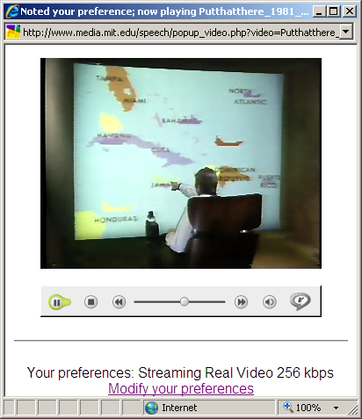
Multimedia Interfaces
Multimedia interface combines different sorts of media modalities to achieve more natural and more efficient human computer communication.
  Speech, audio, touch, video input (patterns, posture, gesture) etc.
“Put that there” is an example multimedia HCI that combines speech, gestures and graphics.
Put that there, MIT 1981

Slide 3
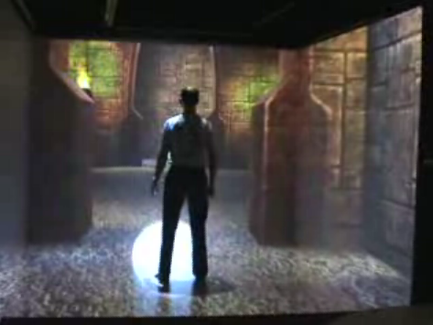
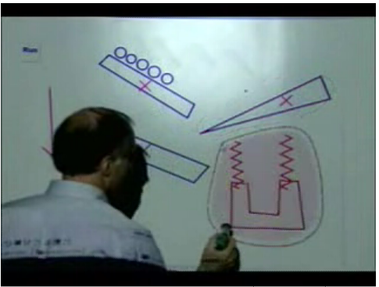
Advantages of Multimedia Interface
More alternative methods.
The flexibility of combining different schemes.
More efficient for specific tasks.
Greater precision of information.
Help handicapped people to use computers.
Pen gesture interface
Virtual Reality

Slide 4
What is important in web design?
Color
Layout
Content
Text – Important to know that the font you intend may not be fonts in user’s browsers.

Slide 5
What is COLOR?
Color is commonly referred to as a property of things
Color, though, exists only in the brain. It is a neural process, triggered by retinal responses to wavelengths of light.

Slide 6
Colors in web design
Color is a powerful component in web design.
It defines a web site's environment and influences the mood and emotion.
Plan the use of colors carefully.
No matter which colors are chosen, colors must be used consistently throughout the design. If used that way, colors create visual boundaries that give a web site a feeling of place.

Slide 7
Choose Colors
Color makes you feel, so select the color support your message
Understand the basics of color theory.
understand how colors complement and interact with each other.
Use a limited palette
Readability

Slide 8
Color Associations
Red
Blue
Green
Yellow
Orange
Black

Slide 9
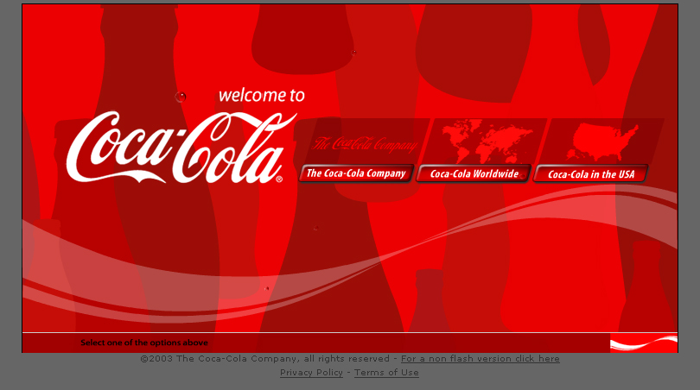

Slide 10
Red
Red is the color of fire and blood
It is associated with energy, war, danger, strength, power, determination as well as passion, desire, and love
Red is a very emotionally intense color.
It enhances human metabolism, increases respiration rate, and raises blood pressure.
It has very high visibility, which is why stop signs, stoplights, and fire equipment are usually painted red.

Slide 11
Red
Red brings text and images to the foreground
Use it as an accent color to stimulate people to make quick decisions
it is a perfect color for 'Buy Now' or 'Click Here' buttons on Internet banners and websites.
Light red represents joy, sexuality, passion, sensitivity, and love

Slide 12
Red
Pink
  signifies romance, love, and friendship. It denotes feminine qualities and passiveness
Dark red
  is associated with vigor, willpower, rage, anger, leadership, courage, longing, malice, and wrath
Brown
  suggests stability and denotes masculine qualities
Reddish-brown
  is associated with harvest and fall

Slide 13
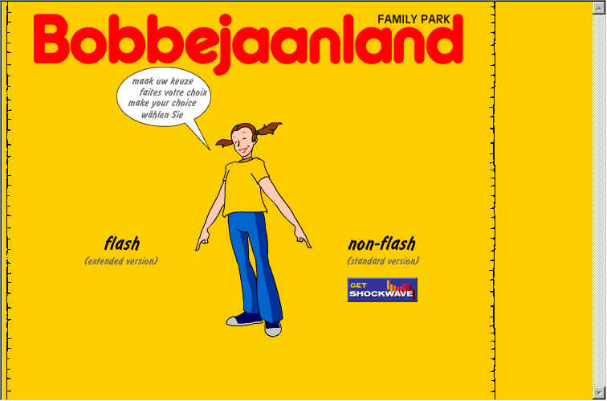

Slide 14
Yellow
Yellow is the color of sunshine. It's associated with joy, happiness, intellect, and energy
Yellow produces a warming effect, arouses cheerfulness, stimulates mental activity, and generates muscle energy
Bright, pure yellow is an attention getter, which is the reason taxi,cabs are painted this color

Slide 15
Yellow
When overused, yellow may have a disturbing effect; it is known that babies cry more in yellow rooms
Yellow is seen before other colors when placed against black; this combination is often used to issue a warning

Slide 16
Yellow
Dull (dingy) yellow
  represents caution, decay, sickness, and jealousy
Light yellow
  is associated with intellect, freshness, and joy

Slide 17
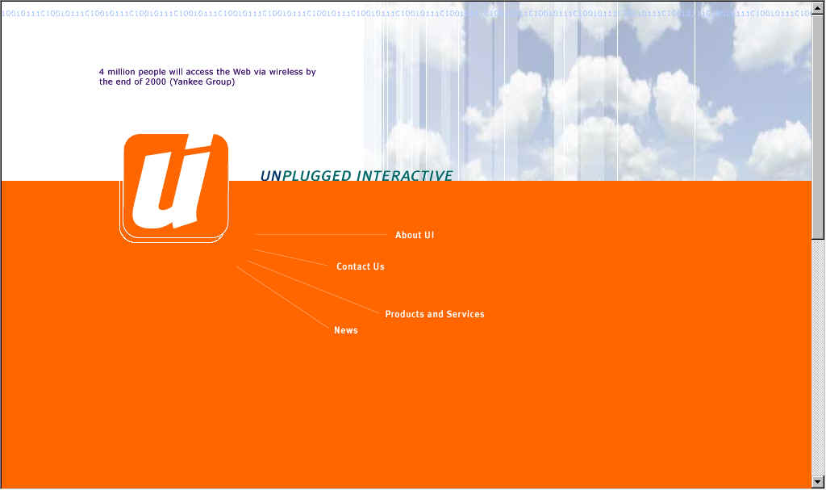

Slide 18
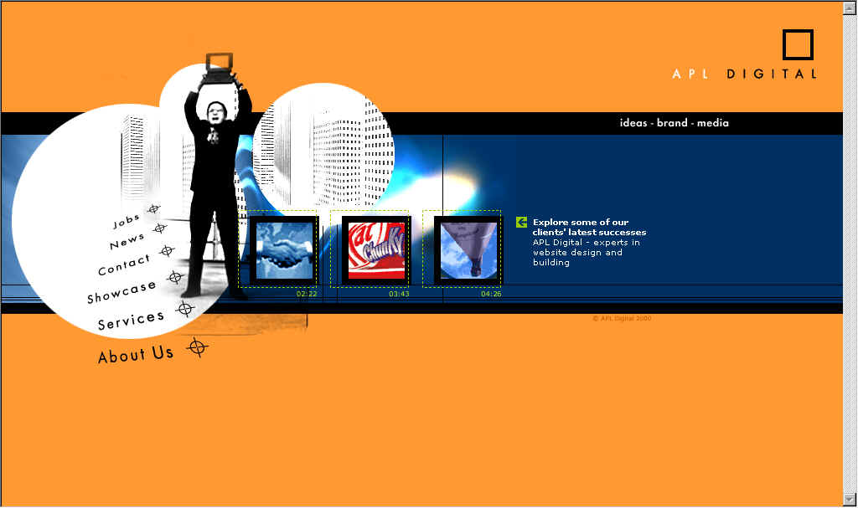

Slide 19
Orange
Orange represents enthusiasm, fascination, happiness, creativity, determination, attraction, success, encouragement, and stimulation
To the human eye, orange is a very hot color, so it gives the sensation of heat

Slide 20
Orange
Orange increases oxygen supply to the brain, produces an invigorating effect, and stimulates mental activity. It is highly accepted among young people. As a citrus color, orange is associated with healthy food and stimulates appetite.
Orange is the color of fall and harvest
Orange has very high visibility, so you can use it to catch attention and highlight the most important elements of your design. Orange is very effective for promoting food products and toys

Slide 21
Orange
Dark orange
  can mean deceit and distrust
Red-orange
  corresponds to desire, sexual passion, pleasure, domination, aggression, and thirst for action
Gold
  evokes the feeling of prestige. The meaning of gold is illumination, wisdom, and wealth. Gold often symbolizes high quality

Slide 22
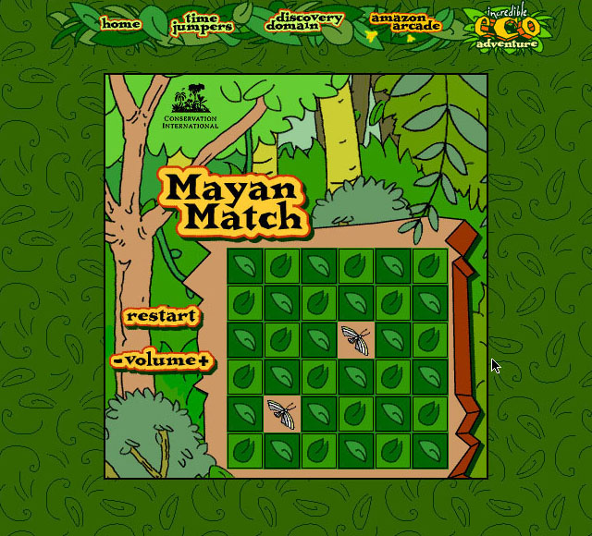

Slide 23
Green
Green is the color of nature. It symbolizes growth, harmony, freshness, and fertility. Green has strong emotional correspondence with safety
Green has great healing power. It is the most restful color for the human eye
Green suggests stability and endurance. Sometimes green denotes lack of experience

Slide 24
Green
Use green to indicate safety when advertising drugs and medical products
Green is directly related to nature, so you can use it to promote ‘green’ products
Dull, darker green is commonly associated with money, the financial world, banking, and Wall Street

Slide 25
Green
Dark green
  is associated with ambition, greed, and jealousy
Yellow-green
  can indicate sickness, cowardice, discord, and jealousy
Aqua
  is associated with emotional healing and protection
Olive green
  is the traditional color of peace

Slide 26


Slide 27
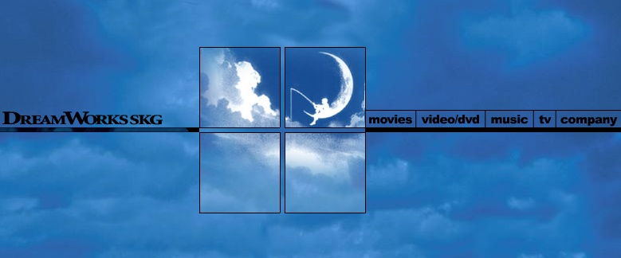

Slide 28
Blue
Blue is often associated with depth and stability.
It symbolizes trust, loyalty, wisdom, confidence, intelligence, faith, truth, and heaven
Blue is considered beneficial to the mind and body. It slows human metabolism and produces a calming effect.
Blue is strongly associated with tranquility and calmness

Slide 29
Blue
You can use blue to promote products and services related to cleanliness (water purification filters, cleaning liquids, vodka), air and sky (airlines, airports, air conditioners), water and sea (sea voyages, mineral water)
As opposed to emotionally warm colors like red, orange, and yellow; blue is linked to consciousness and intellect . Use blue to suggest precision when promoting high-tech products

Slide 30
Blue
Blue is a masculine color; according to studies, it is highly accepted among males. Dark blue is associated with depth, expertise, and stability;
it is a preferred color for corporate America
Avoid using blue when promoting food and cooking, because blue suppresses appetite.
When used together with warm colors like yellow or red, blue can create high-impact, vibrant designs; for example, blue-yellow-red is a perfect color scheme for a superhero

Slide 31
Blue
Light blue
  is associated with health, healing, tranquility, understanding, and softness
Dark blue
  represents knowledge, power, integrity, and seriousness

Slide 32
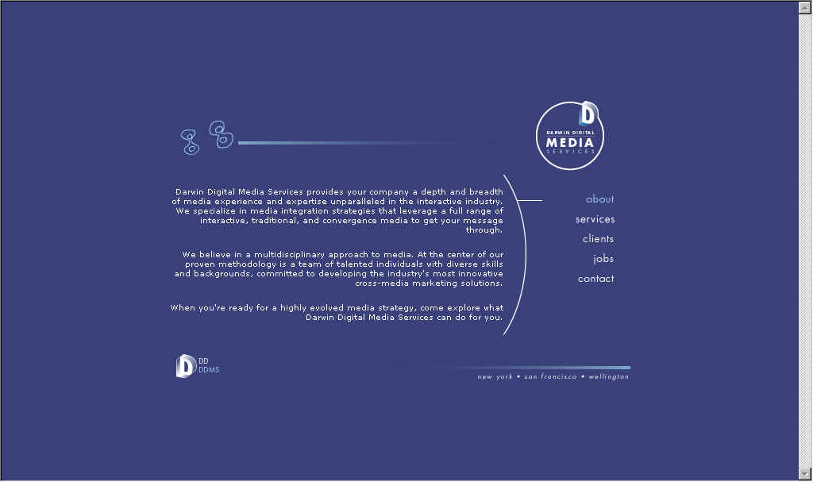

Slide 33
Purple
Purple combines the stability of blue and the energy of red. Purple is associated with royalty
It symbolizes power, nobility, luxury, and ambition. It conveys wealth and extravagance
Purple is associated with wisdom, dignity, independence, creativity, mystery, and magic

Slide 34
Purple
According to surveys, almost 75 percent of pre-adolescent children prefer purple to all other colors.
Purple is a very rare color in nature; some people consider it to be artificial
Light purple is a good choice for a feminine design. You can use bright purple when promoting children's products

Slide 35
Purple
Light purple
  evokes romantic and nostalgic feelings
Dark purple
  evokes gloom and sad feelings. It can cause frustration

Slide 36
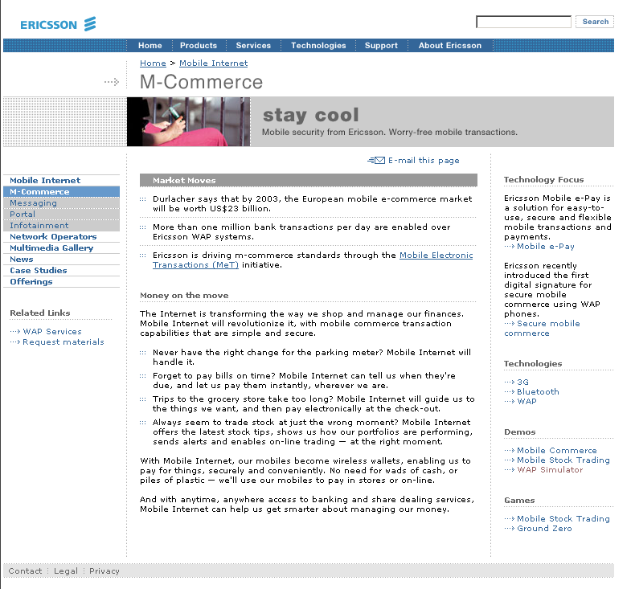

Slide 37
White
White is associated with light, goodness, innocence, purity, and virginity
It is considered to be the color of perfection.
White means safety, purity, and cleanliness.
You can use white to suggest simplicity in high-tech products
White is an appropriate color for charitable organizations; angels are usually imagined wearing white clothes

Slide 38
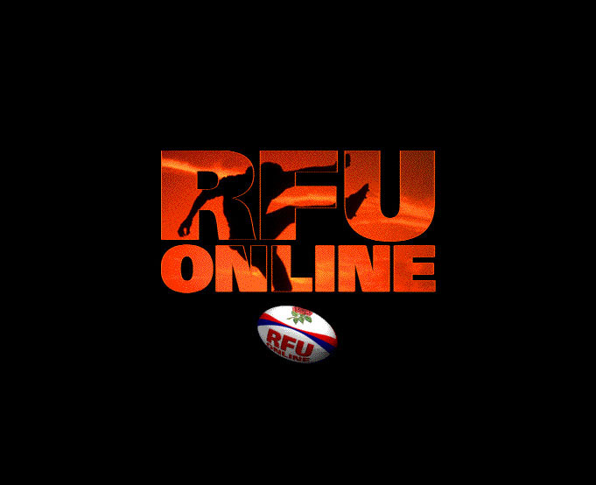

Slide 39
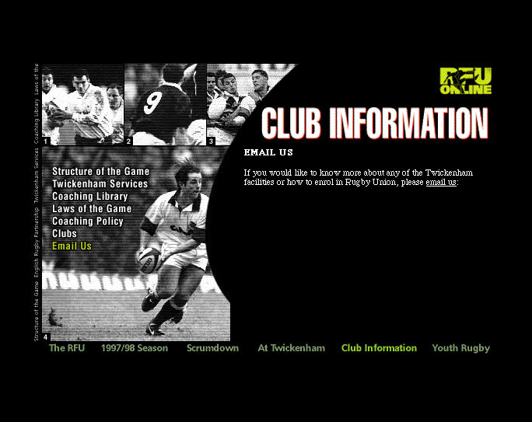

Slide 40
Black
Black is associated with power, elegance, formality, death, evil, and mystery
Black is a mysterious color associated with fear and the unknown (black holes)
Black denotes strength and authority; it is considered to be a very formal, elegant, and prestigious color (black tie, black Mercedes)
Black contrasts well with bright colors. Combined with red or orange - other very powerful colors - black gives a very aggressive color scheme

